Slide 1

A Real Time Driver Drowsiness Detection and Alert System
By
Name 1: V.Mounika Jaya (22BFA33138)
Name 2: K.Cherishma (22BFA33097)
Name 3: Jadala Vaishnavi (22BFA33094)
Name 4: Muddukuppam Dilli Prasad (22BFA33123)
Under the guidance of
Dr J.Sarada
Associate Professor
Department of CSE (AI & ML)
DEPARTMENT OF COMPUTER SCIENCE AND ENGINEERING (AI & ML)
SRI VENKATESWARA COLLEGE OF ENGINEERING
(Autonomous)
Karakambadi Road, Tirupati-517507
2022-2026

Slide 2
OUTLINE
Abstract
Introduction
Problem Statement
Existing system
Disadvantages
Proposed system
Advantages
Software Requirements
Hardware Requirements
System Architecture
Modules
UML Diagrams
Output Screens
Future Enhancements
Conclusion

Slide 3
ABSTRACT
To enhance road safety, this project proposes a real-time drowsiness detection system using Deep Learning with Convolutional Neural Networks (CNNs). The system analyzes a driver's facial expressions and eye movements to determine signs of fatigue and alertness. The model is trained on a dataset of facial images categorized into drowsy and non-drowsy states. Using CNN, the system extracts key facial features such as eye closure, yawning, and head position to detect drowsiness. A camera continuously captures frames of the driver’s face, and the trained CNN model classifies them in real-time. If drowsiness is detected, an alert mechanism (such as a voice alarm) is triggered to wake the driver. The system is implemented using OpenCV, TensorFlow/Keras, and Python, The proposed solution is highly effective in reducing accidents caused by driver fatigue, providing a low-cost and scalable approach to road safety.

Slide 4
INTRODUCTION
Drowsiness is one of the primary drivers of genuine car crashes in our day-by-day lives. The National Highway Traffic Safety Administration indicated that around 150 individuals are murdered in the United States every year due to driver tiredness. 71,000 harmed and $12.5 billion in misfortunes . Another report showed that the U.S.A government and organizations spend about $60.4 billion every year on mishaps identified with drowsiness. Due to drowsiness, it costs buyers about $16.4 billion in property harm, well-being cases, time, and efficiency misfortunes. Drive. In 2010, the National Sleep Foundation (NSF) detailed that 54% of grown-up drivers felt sluggish while driving a vehicle, and 28% were, in reality, sleeping. The German Road Safety Commission (Deutsche Verkehrs sicherheitsrat (DVR)) claims that a snapshot of driver tiredness brings about one-fourth of the through-way car accidents. Massive setbacks, wounds, and property harm brought about by drowsiness require critical strides in building up a robust framework that can identify drowsiness and make the right move before a mishap happens—the U.S.A Department of Transportation has additionally gained ground in assembling savvy vehicles to avoid such accidents. As individuals become progressively keen on wise transportation frameworks, developing a robust and down-to-earth sluggishness recognition framework is a critical advance. A great deal of research is at present in progress.

Slide 5
PROBLEM STATEMENT
Driver fatigue and drowsiness are major causes of road accidents worldwide, leading to loss of life, injuries, and property damage.
Traditional methods of monitoring driver alertness rely on self-awareness or manual checks, which are unreliable and ineffective in real-time scenarios.
There is a critical need for an automated, real-time system that can continuously monitor a driver’s facial expressions and eye movements to accurately detect signs of drowsiness. Such a system should be low-cost, efficient, and capable of providing immediate alerts to prevent accidents caused by reduced driver alertness.

Slide 6
EXISTING SYSTEM
Current drowsiness detection systems monitoring the driver’s condition requires complex computation and expensive equipment, not comfortable to wear during driving and is not suitable for driving conditions. For example, Electroencephalography (EEG) and Electrocardiography (ECG), i.e, detecting the brain frequency and measuring the rhythm of heart, respectively. A drowsiness detection system which use a camera placed in front of the driver is more suitable to be use but the physical signs that will indicate drowsiness need to be located first in order to come up with a drowsiness detection algorithm that is reliable and accurate. Lighting intensity and while the driver tilt their face left or right are the problems occur during detection of eyes and mouth region.

Slide 7
DISADVANTAGES
It does not execute very well when the data set has more sound i.e. target classes are overlapping. In cases where the number of properties for each data point outstrips the number of training data specimens, the support vector machine will underperform.
The system may not work well when there are sudden changes in lighting conditions, such as driving at night, bright sunlight directly hitting the face, or passing through tunnels. These variations can confuse the camera and reduce the accuracy of eye-blink or yawning detection.

Slide 8
PROPOSED SYSTEM
The proposed system detects driver drowsiness in real time using deep learning techniques. A camera continuously captures the driver’s facial images, which are analyzed using a Convolutional Neural Network (CNN) to identify signs such as eye closure and head position. The system classifies the driver’s state as either alert or drowsy.
The model is trained using the MRL Eye Dataset, which contains approximately 80,000 images of open and closed eyes, with 60,000 images used for training, 10,000 for testing, and 10,000 for validation. When drowsiness is detected, the system immediately generates audio alerts to warn the driver. The implementation uses Streamlit as the framework, OpenCV for image processing, NumPy for numerical operations, and TensorFlow for building and training the deep learning model.

Slide 9
ADVANTAGES
Providing real-time drowsiness feedback to the driver.
Providing performance feedback to a fatigue management program.
Providing regulatory compliance information to enforcement officials.

Slide 10
SYSTEM REQUIREMENTS
Software Requirements:
Operating system: Windows 10/11
Programming Language: Python
Development Environment: Visual Studio Code
Framework: Streamlit
Libraries & Packages:
OpenCV (for image processing)
NumPy (for array and matrix operations)
TensorFlow

Slide 11
SYSTEM REQUIREMENTS
Hardware Requirements:
Processor: Intel i3 or above
CPU Speed: 1.6 GHz or higher
Hard Disk: 256 GB
Display: 15’’ LED Monitor
Input Devices: Keyboard, mouse
RAM: 4 GB or Above

Slide 12
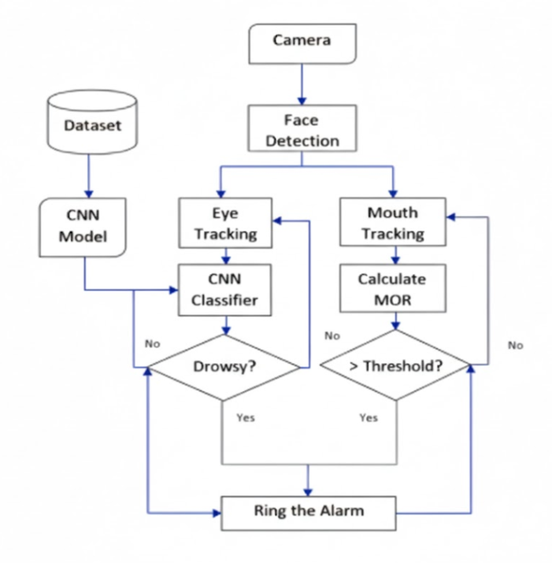
SYSTEM ARCHITECTURE

Slide 13
SYSTEM ARCHITECTURE
The system starts by collecting facial images from a dataset to train the CNN model.
A camera captures live video of the driver during driving.
Face detection is applied to locate the driver’s face in each video frame.
Eye tracking is performed and the eye features are given to the CNN classifier.
The CNN classifier checks whether the driver is drowsy or not.
At the same time, mouth tracking is done and the Mouth Opening Ratio (MOR) is calculated.
The MOR value is compared with a threshold to detect yawning.
If either eye-based detection or mouth-based detection indicates drowsiness, the system confirms drowsiness.
Once drowsiness is detected, the alarm rings to alert the driver.

Slide 14
Modules
Data Acquisition Module
Preprocessing and Augmentation Module
Feature Extraction Module
Deep learning/Classification Module
Result and Alert Module

Slide 15
Modules
1. Data Acquisition Module:
This module is responsible for capturing live video frames of the driver’s face using a camera installed in the vehicle.
The system may also utilize a pre-collected dataset of labeled facial images showing alert and drowsy states for training the model.
Accurate data acquisition ensures that the model can effectively learn and monitor signs of drowsiness in real-time conditions.
2. Preprocessing and Augmentation Module:
The captured facial images are preprocessed to enhance the model’s performance.
Preprocessing steps include resizing images to a standard dimension, converting to grayscale if necessary, and normalizing pixel values.
Data augmentation techniques such as rotation, flipping, and brightness adjustment are applied to increase dataset diversity and improve model.

Slide 16
Modules
3. Feature Extraction Module:
The system uses a Convolutional Neural Network (CNN) to automatically extract relevant features from the driver’s facial images.
Key features include eye closure, frequency of yawning, and head tilt or nodding. The CNN layers identify
both local and global patterns in the images, transforming raw data into feature representations suitable for classification.
4. Deep Learning/Classification Module:
Extracted features are fed into the trained CNN model to classify the driver’s state as either alert or drowsy.
The model continuously evaluates frames in real time, providing high accuracy in detecting fatigue.
Classification results are generated for each frame, allowing the system to determine the driver’s vigilance level dynamically.

Slide 17
Modules
5. Result and Alert Module:
Once drowsiness is detected, this module triggers immediate notifications to the driver through audio and visual alerts.
The system may also log results for further analysis, such as tracking driver alertness patterns over time.
This module ensures timely intervention, reducing the risk of accidents caused by driver fatigue.

Slide 18
UML DIAGRAMS
What is UML?
The Unified Modelling Language (UML) is a standard language for specifying, visualizing, constructing, and documenting the artifacts of software systems, as well as for business modelling and other non-software systems.
In this project seven basic UML diagrams have been explained:
Class Diagram
Use Case Diagram
Sequence Diagram
Activity Diagram
Component Diagram
Deployment Diagram
Collaboration Diagram

Slide 19
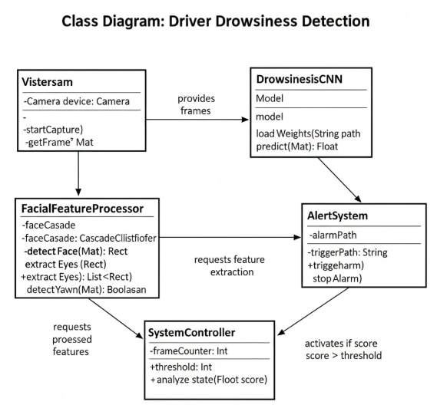
Class Diagram
Shows the structure of a system by representing classes, their attributes, methods, and relationships.

Slide 20
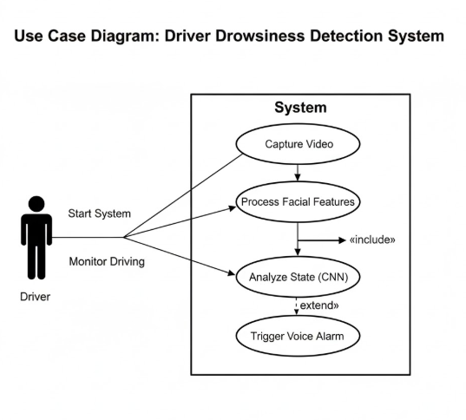
Use Case Diagram
Describes how users (actors) interact with the system and its functionalities.

Slide 21
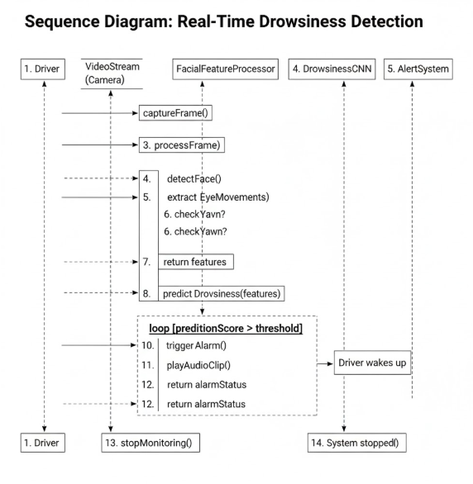
Sequence Diagram
Illustrates the order of interactions between objects over time.

Slide 22
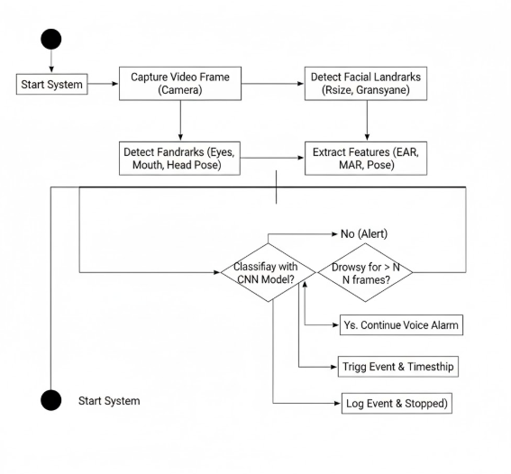
Activity Diagram
Represents the workflow or step-by-step process of activities in a system.

Slide 23
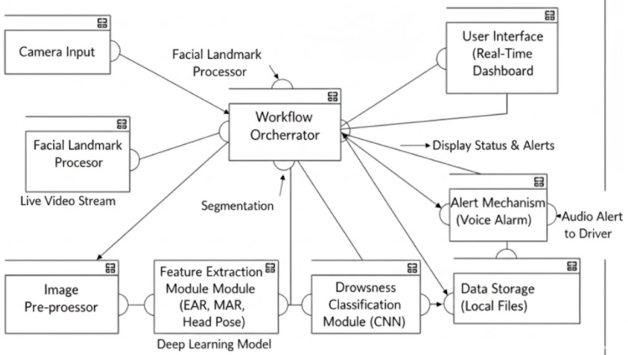
Component Diagram
Shows how different software components are organized and interact with each other

Slide 24
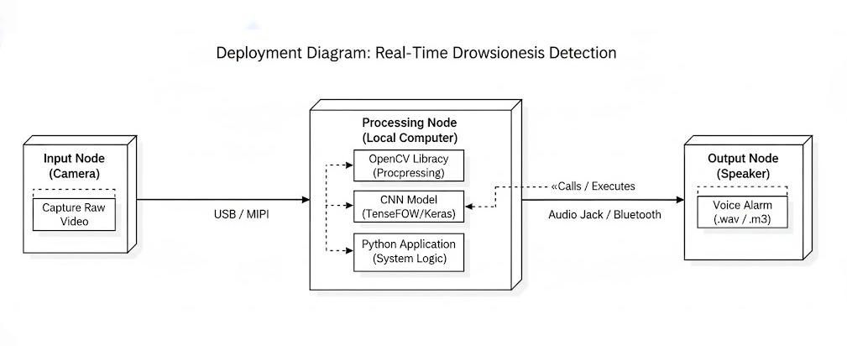
Deployment Diagram
Displays the physical deployment of software on hardware (servers, devices, etc.).

Slide 25
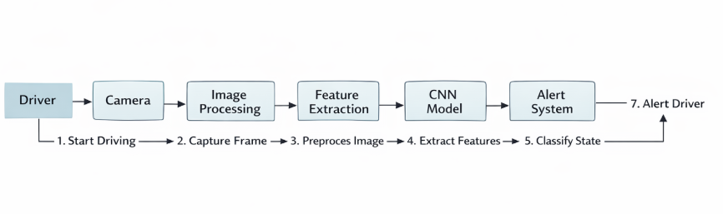
Collaboration Diagram
Shows how objects interact with each other through messages to complete a task, focusing more on relationships between objects rather than the sequence of events

Slide 26
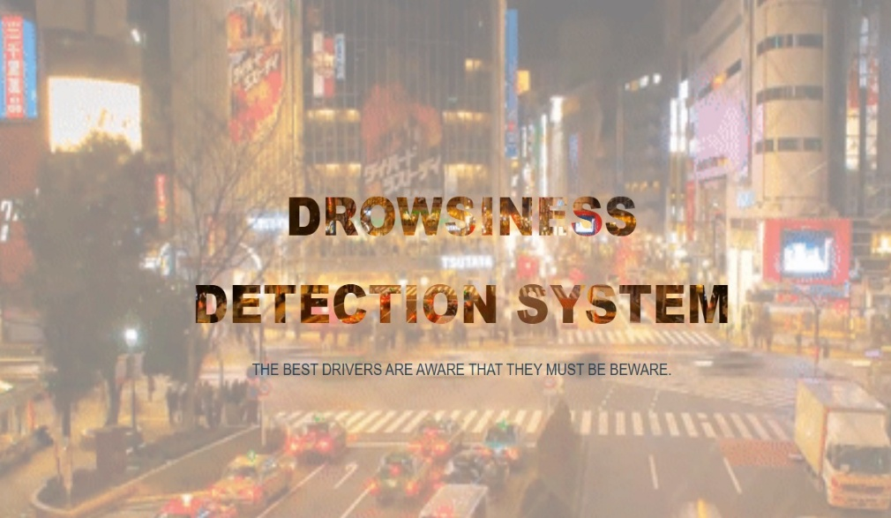
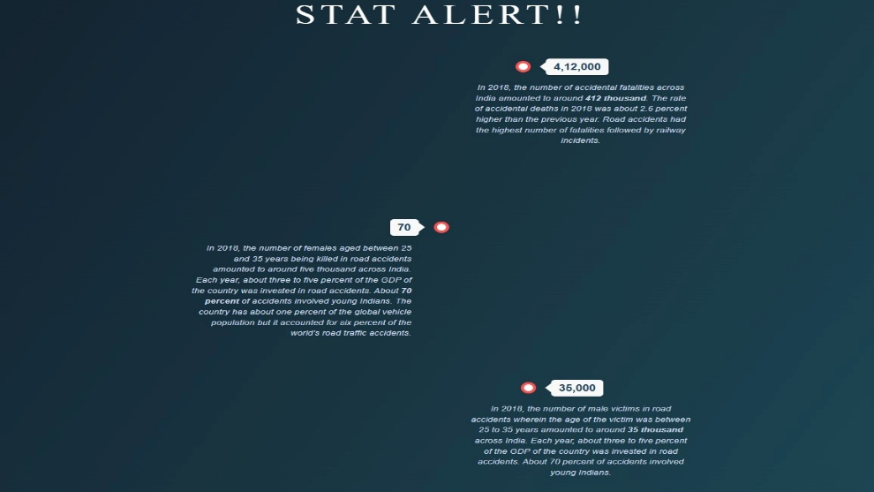
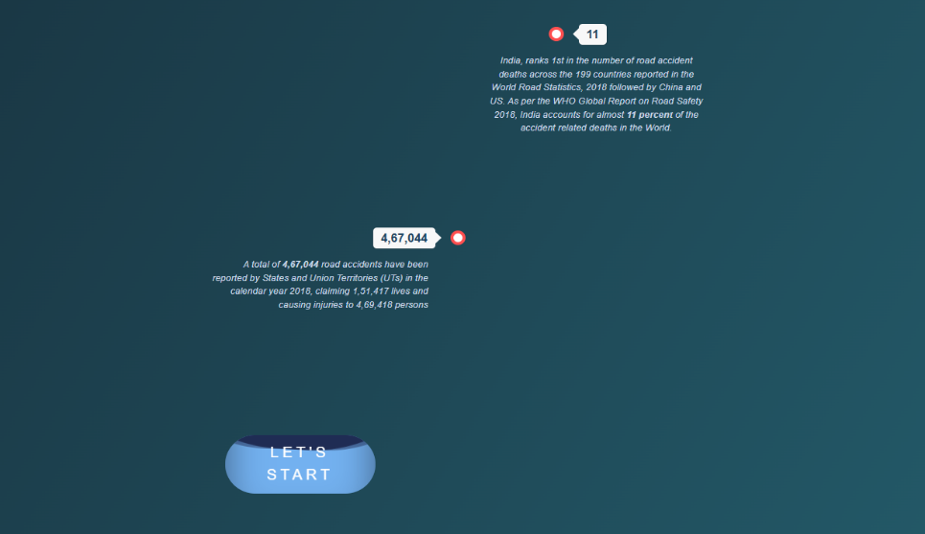
Output
Interface Layout

Slide 27
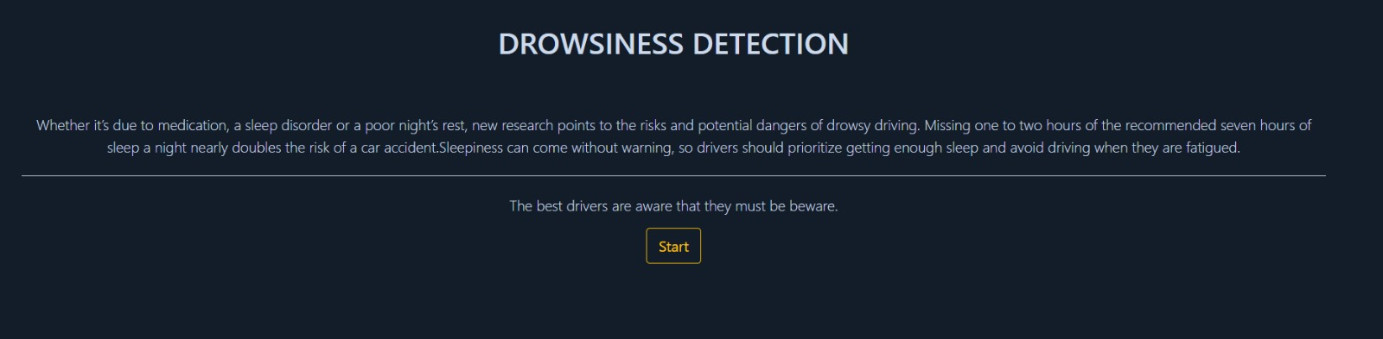
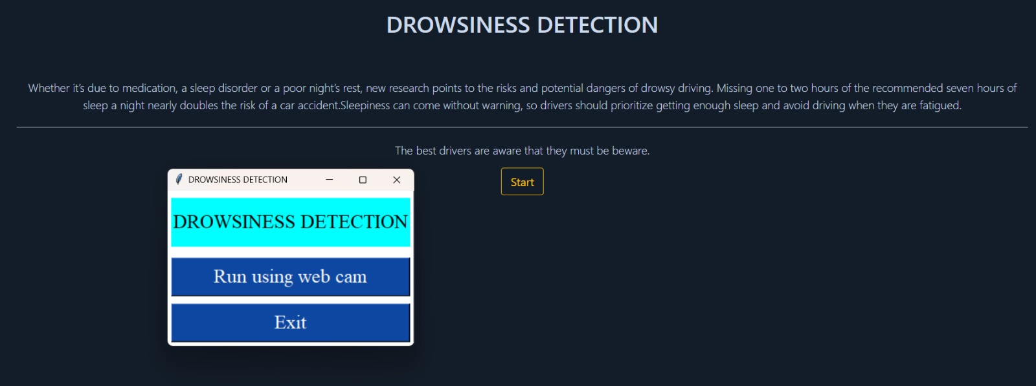
Output
Detection GUI Window

Slide 28
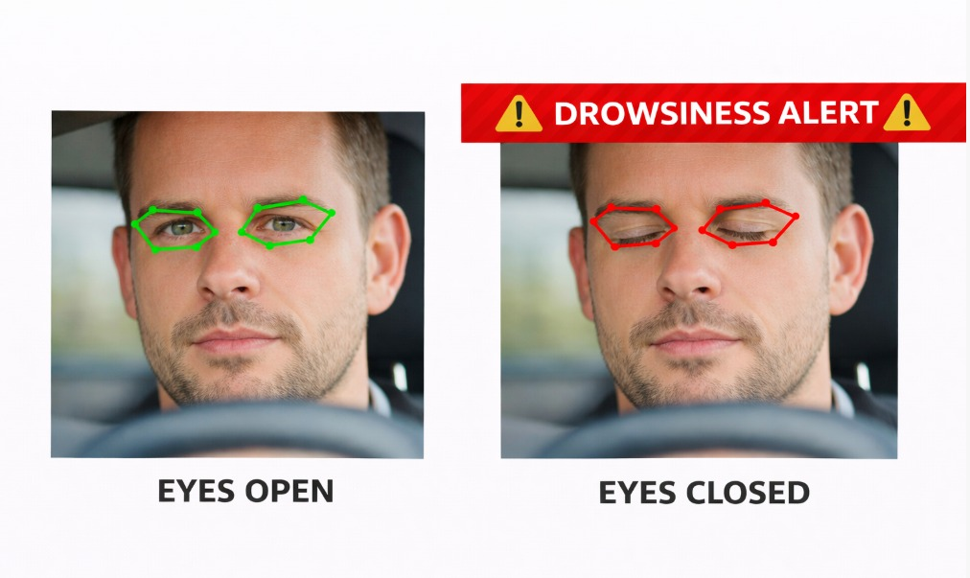
Output
Eye blink and Closure detection for Drowsiness

Slide 29
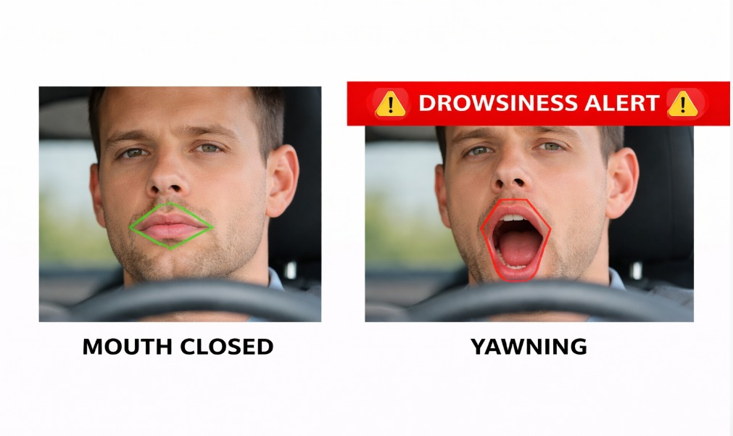
Output
Mouth State Analysis for Drowsiness Detection

Slide 30
Future Enhancements
The Real-Time Driver Drowsiness Detection System can be further improved by integrating advanced technologies and additional features to enhance accuracy, usability, and safety. Some of the possible future enhancements are as follows:
Integration with Smart Vehicles
The system can be integrated directly into modern vehicles and smart transportation systems to continuously monitor driver behavior and automatically take preventive actions.
Automatic Vehicle Control
In critical situations, the system can be connected with the vehicle control system to reduce vehicle speed or safely stop the vehicle if the driver does not respond to alerts.

Slide 31
Future Enhancements
Mobile Application Integration
A mobile application can be developed to monitor driver alertness, store driving data, and send notifications or alerts to the driver’s smartphone.
Advanced Deep Learning Models
More advanced deep learning architectures such as ResNet, EfficientNet, or Vision Transformers can be used to improve the accuracy and robustness of drowsiness detection.
Multiple Driver Monitoring
The system can be enhanced to support multiple cameras to monitor the driver from different angles, improving detection accuracy in different driving conditions.

Slide 32
Future Enhancements
Cloud-Based Data Storage and Analysis
Driver alertness data can be stored in the cloud to analyze driving patterns, generate reports, and improve long-term safety monitoring.
Integration with GPS and Emergency Alerts
The system can be integrated with GPS tracking to send emergency alerts or location information to family members or authorities if the driver becomes unresponsive.
These enhancements will make the system more intelligent, reliable, and suitable for real-world applications in modern vehicles and transportation systems.

Slide 33
Conclusion
Developed a real-time driver drowsiness detection system to improve road safety
Uses computer vision and deep learning (CNN) to analyze eye closure, blinking, and yawning
Detects driver fatigue and provides instant alert through alarm system
Works in real-time using camera-based monitoring
Cost-effective, non-intrusive, and easy to implement
Helps reduce accidents caused by driver drowsiness

Slide 34


